Slide 1




MINI-PROJECT
PRESENTATION
Topic:"Cancer Incidence Prediction"
Presented by : Sairaj Patro (23909)
Guided by: Sri Satha Sai Mudigonda and
Dr. K Vengata Krishnan

Slide 2


Placed at Thy Lotus Feet

Slide 3
Agenda
1
Problem Statement
2
Domain Knowledge
3
Literature Review
4
Prediction
Visualisation
5
6
Future Extension

Slide 4
Problem Statement
To Develop a machine learning model to predict cancer incidence rates among various states in India solely based on historical data. Utilize features such as population demographics, cancer prevalence trends, and any other relevant historical indicators to forecast cancer incidence rates for each state over the next 20 years. The objective is to provide accurate predictions that can assist healthcare planners and policymakers in understanding the future cancer burden across different regions of India, thereby facilitating resource allocation and the implementation of targeted interventions to address anticipated healthcare needs.

Slide 5
Domain Knowledge:
Cancer Basics:
Cancer is a group of diseases characterized by the uncontrolled growth and spread of abnormal cells in the body.
It can affect almost any part of the body and may lead to serious health complications and death if not treated effectively.
Cancer Epidemiology:
Cancer incidence refers to the number of new cancer cases diagnosed in a specific population over a given time period.
Cancer prevalence refers to the total number of people living with cancer within a population at a specific point in time.
Cancer mortality refers to the number of deaths attributed to cancer within a population over a given time period.
Risk Factors:
Various factors contribute to the development of cancer, including genetic predisposition, environmental exposures (e.g., tobacco smoke, UV radiation), lifestyle choices (e.g., diet, physical activity), infectious agents (e.g., HPV, H. pylori), and occupational hazards.
Some risk factors are modifiable (e.g., smoking cessation, healthy diet), while others are non-modifiable (e.g., age, family history).

Slide 6
Domain Knowledge:
Cancer Screening and Diagnosis:
Early detection of cancer through screening can improve treatment outcomes and survival rates.
Common screening tests include mammography for breast cancer, colonoscopy for colorectal cancer, Pap smear for cervical cancer, and PSA testing for prostate cancer.
Diagnosis of cancer involves a combination of physical examination, imaging tests (e.g., X-rays, MRI), laboratory tests (e.g., blood tests, biopsies), and pathological analysis of tissue samples.
Cancer Treatment:
Treatment options for cancer vary depending on the type, stage, and location of the cancer, as well as the patient's overall health and preferences.
Common cancer treatments include surgery, chemotherapy, radiation therapy, immunotherapy, targeted therapy, and hormone therapy.
Cancer Prevention and Control:
Prevention strategies aim to reduce the risk of developing cancer through lifestyle modifications (e.g., healthy diet, regular exercise), avoiding exposure to carcinogens (e.g., tobacco, asbestos), vaccination against cancer-causing viruses (e.g., HPV, hepatitis B), and early detection through screening.

Slide 7
Literature Review
Types of Cancer:
There are total 200+ types of cancer avilable in total.
In india there are around 19 types of cancers generally occurs.
Results from Various Research Papers:
In 2022, India had 14,61,427 cancer cases, which is 100.4 per 100,000 people.
One in nine people in India may develop cancer in their lifetime.
Compared to men, Women have more chances to encounter with cancer, but men have more chances to die than women.
Among Men 50% have Lung Cancer (can be reduced by awareness)
Uttar Pradesh, Maharashtra,Bihar,Karnataka are the states having most number of cases in India.
India is Lagging behind healthcare facility when it comes to cancer.
There is no much impact of awareness.
More callenges faced during data collection.

Slide 8
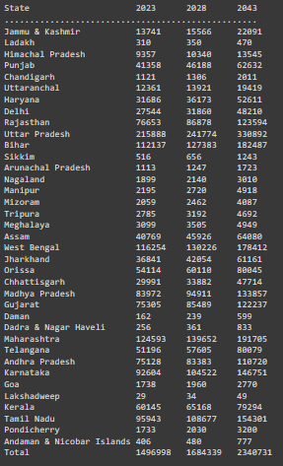
Prediction
Based on the historical data available,here is the prediction for the next 5 year and next 20 years:

Slide 9
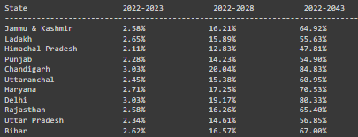
Prediction
The below is the percentage increase prediction of the targeted years:

Slide 10
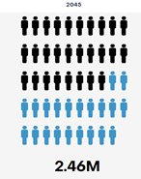
Validation of the Result
Prediction by the machine learning model(for 2045)
Prediction by WHO using some statistical method(for 2045).
2.43M

Slide 11
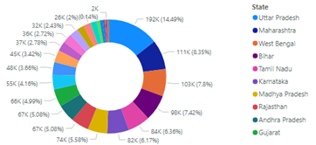
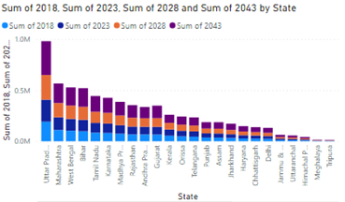
Visualiazation
Pie Chart:
Stacked Bar Graph:

Slide 12
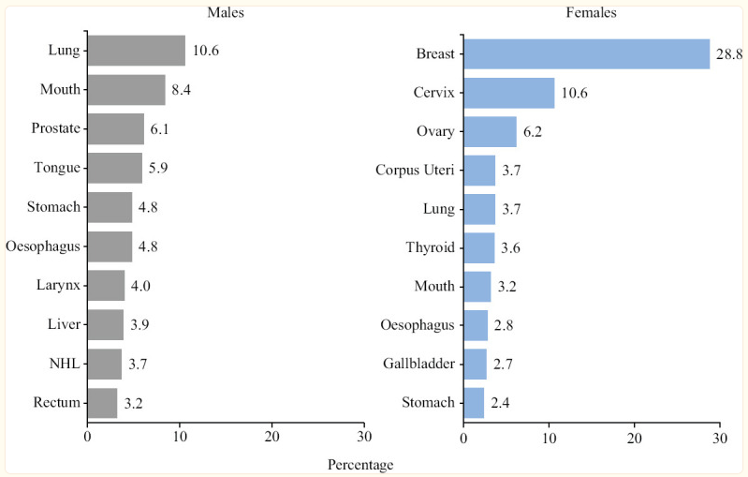
Visualiazation
Bar Graph:

Slide 13
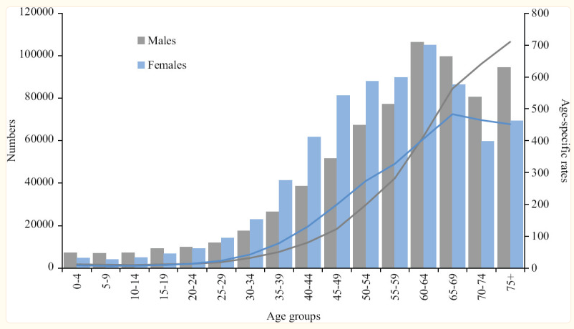
Visualization
Age Specific result:

Slide 14
Future Extentions
More work can be done on all the individual type of cancers for all the states in India which will help government to take proper action against it.
An insurance premium model can be made which will give the policymakers a deep understanding for selecting their customers.
Also the model will be helpful for the common people to choose their plan accordingly.

Slide 15
﻿THANK YOU
JAI SAIRAM

